Slide 1
Name
Institution
Date
Law

Slide 2
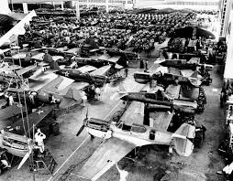
Government policy during WWII
Industries conversion to war needs from peacetime
Civilians protection
Engagement in war missions
Volunteering to war
Notes:
President Roosevelt before entering WWII established a policy whose task was to convert industries to war needs from peacetime work through allocation of materials, priorities establishment in materials distribution and prohibit production that was not essential. The policy of preparation and readiness to war coordinated federal and state measures for the civilians protection in cases of emergencies regarding war. Furthermore, citizens were commissioned to engaged and patrol in rescues and search missions. 1o mullion volunteers were organized in an effort to fight fires, decontaminate following chemical weapons attacks and provide first aid in case of emergencies. Furthermore, the government launched a successful program where the youth would be recruited and trained with an aim of fighting the enemy to protect the US. With this in mind, there were a number of communication tools that would hence be used to prepare and make the relevant communication needed for the overall strategy of winning.

Slide 3
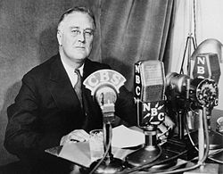
Main means of communication during WWII
Radio broadcasts and newspapers
Americans were kept informed
People gathered to hear about what was happening overseas
Following battles became easy
Notes:
In the United States, the two common means of communication during WWII were newspapers and radio broadcasts. These two sources were influential as they made it possible to connect people from their homes and kept them informed about the progress of the overseas fighting as well as the impact that were on these communities. In the WWII, war correspondents would sped a good deal of time with troops such as in planes, on the ground and even aboard ships. With this efforts, the radio broadcast would bring the war into living rooms of the citizens as families would gather around to have an idea of hat was happening overseas. When it came to television, it included war effort uplifting stories, combat dramatic footage and segments which featured politicians and generals with explanations of latest strategies and developments.

Slide 4
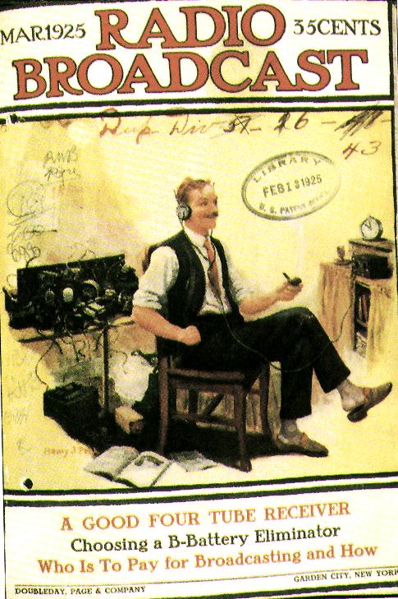
Political communication bias, accuracy and omission
Information was first hand
Information was free from errors
Notes:
When it came to newspapers and radio broadcasts as means of communicating policies in the US during WWII, they were seen to communicate information through the best ways possible. This is because, they had the right methodology to communicate ideas to people concerning the war making it possible to develop the necessary tools and take precaution in the best way possible. Information from these two tools used to communicate the policies were free from distortion as information was first hand. Overall, there was revelation of the right and correct information which led to the best possible ways to implement the policies hence attainment of the overall expectations. Before communicating information to respondents, errors would be checked and corrected if there were any of them.

Slide 5
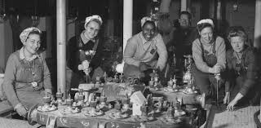
Role of communication in indicating roles
Demonstrating
Stating
Insisting
Women roles
Notes:
It has always been the idea that before information is released to the concerned authorities, there should be a determination made so as to make it successful in indicating the roles to the concerned authorities. There was comprehensively in the role of the government to control the information that was on newspapers and radio broadcasts to minimize information misinterpretation regarding the war. In the year 1942, there was a code of practices regarding wartime on instructions regarding handling of news. The code was implemented by majority of the organizations that were influential in releasing information. Furthermore, the government heavily relied on the patriotism of reporters who ensued the right information was collected and presented to enhance understanding of roles. Overall, interest groups, media and parties played relevant roles in shaping the policy towards conquering the war among the enemies. Women were not left behind as they engaged in activities that were best suitable to them enabling the right and effective measures towards winning.

Slide 6
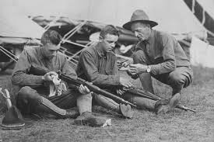
The effect on citizens’ lives
Commitment
Teamwork towards tasks
Identification of duties and responsibilities
Notes:
There was the dire need to produce as many war weapons as possible in the US industries to cope with the challenges that came along for the safety of the Americans. One of the effects that newspapers and radio broadcasts had on the lives of citizens towards mass production of war weapons was commitment. People moved towards attaining the best weapons in the industries that would help towards winning against their enemies in the war. Secondly, there were teams created each with its own tasks towards the best strategies implementation which would aid in manufacture of the right weapons. Furthermore, citizens became aware of their duties and responsibilities which made t possible to manufacture weapons that led to accomplishments of the expectations towards winning the war. Nuclear bombs were well developed which were used in Japan at Hiroshima and Nagasaki leading to sufferings after the bombing.

Slide 7
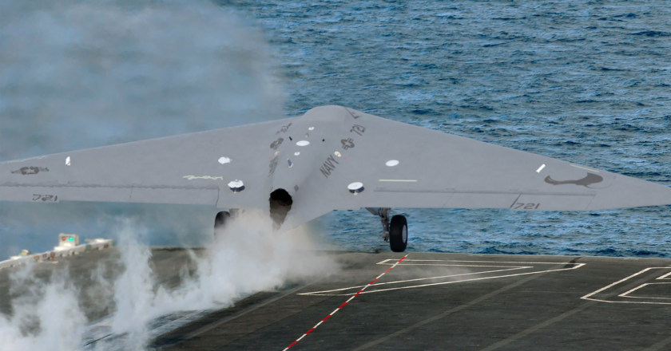
Social cultural aspects
Education
Technological advancements
Teamwork enhanced huge impacts on people lives
Notes:
The role of industries in enhancing technological advancements in the US during the WWII had huge impacts on social cultural aspects. The two main social cultural aspects with regard to the idea of industries conversion to war needs were education and technological advancements. The United States in terms of education became one of the leading nations of the world with the elites which led to a number of accomplishments towards a prosperous life. When it came to technological advancements, the US became a first world country where majority of the citizens contributed to its success. The US became a super power country where it developed technologically and citizens became intellectual towards various technological areas. The policy of converting industries impacted the social aspects of education and technology positively as citizens develops an attitude towards a better society years later. Currently, the US has made it possible to have the right and relevant education channels and technology.

Slide 8
References
Hyslop, S. G., & In Kagan, N. (2018). Eyewitness to World War II: Unforgettable stories from history's greatest conflict.
Ondaatje, M. (2018). Warlight.
Birmingham, J. (2005). Weapons of choice: World War 2.1. Sydney: Pan Macmillan.

